Slide 1
An Introduction to Agent-Based Life Cycle Assessment with Python
Julien Walzberg
ACLCA pre conference workshop
September 25, 2023

Slide 2
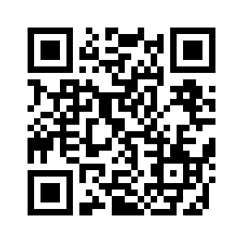
Reminder!
This should be an interactive experience. Make sure to:
Clone the ACLCA_Workshop_AB-LCA repository (follow the link or QR code below).
Install the required Python packages on your base or dedicated environment (see instructions in the repository).
Start the "ACLCA_Workshop_AB-LCA" Jupyter notebook (we will be using it after this presentation).
https://github.com/jwalzberg/ACLCA_Workshop_AB-LCA/

Slide 3
Background

Slide 4
Background – Problem statement
A techno-economic representation of a product system is necessary but not always sufficient.
Modeling detailed human or organization behaviors can improve LCA realism. For example:
Transitioning to a circular economy (CE) implies changes in production and consumption behaviors → a better modeling of those behavior can help inform when CE systems are truly beneficial.
Information and communication technologies (ICT) are notoriously hard to model in LCA because of the uncertainty around user behavior → once again, incorporating information on behavior can provide better insights into the system and its environmental impacts.
From recent advances in economics (e.g., from Khaneman and Thaler):
Human behaviors (and therefore organizational behaviors) are not necessarily rational (i.e., do not necessarily maximize utility).
They are heterogeneous, constrained (by the technological environment, by social norms) & evolve.
“[…] homo economicus can think like Albert Einstein, store as much memory as IBM’s Big Blue and exercise the willpower of Mahatma Gandhi. […] But […] real people have trouble with long division […], sometimes forget their spouce’s birthday, and have a hangover on New Year’s Day.” – Richard H. Thaler & Cass R. Sunstein

Slide 5
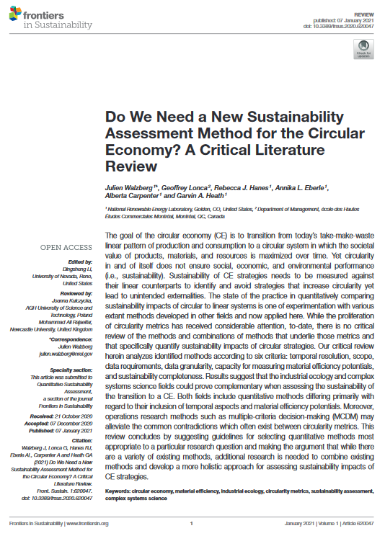
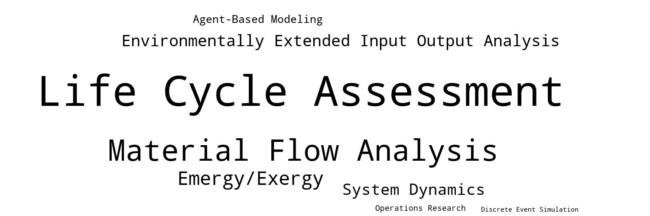
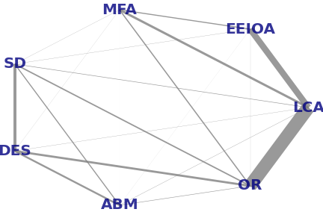
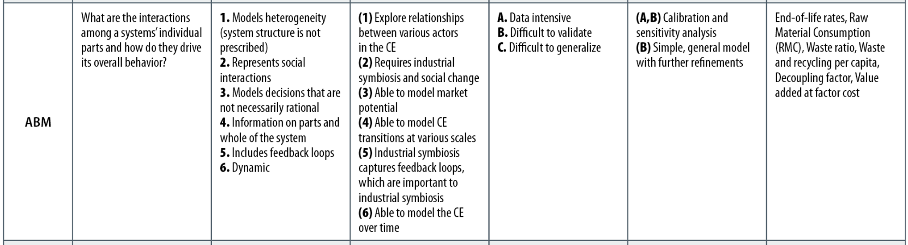
Background – Methodology choice
Methods from industrial ecology have been mostly used for circularity assessment (see word cloud).
Combining methods from industrial ecology and complex systems science (graph) could alleviate some of their respective shortcomings.
Walzberg, J., Lonca, G., Hanes, R., Eberle, A., Carpenter, A., & Heath, G. A. (2020). Do we need a new sustainability assessment method for the circular economy? A critical literature review. Frontiers in Sustainability, 1, 12.

Slide 6
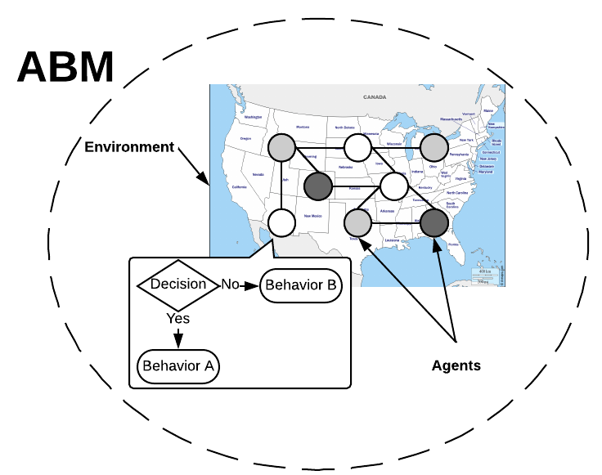
Background – Agent-based modeling
A good method to model human behaviors is agent-based modeling.
Agent-based modeling (ABM):
Bottom-up modeling where each agent follows its own behavioral rules.
Agent: individual entity which has its own characteristics, behaviors and can interact with each other and with the environment.
Goal: Understand how a system’s macro level behavior emerges from the individual behaviors of the agents.
Advantages of the ABM method:
Model individual decisions and peer effects.
Represent a population heterogeneity.

Slide 7
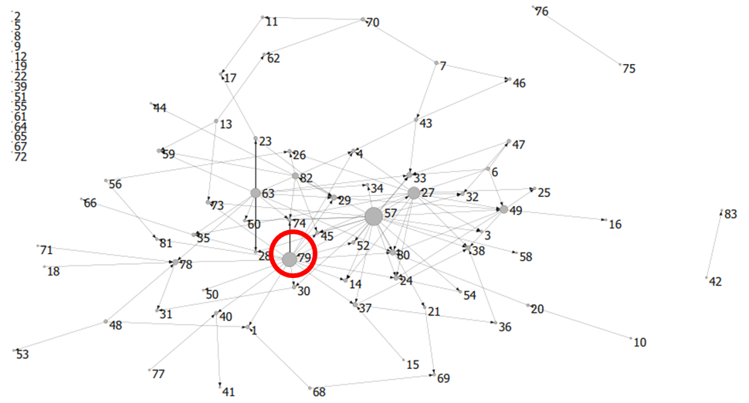
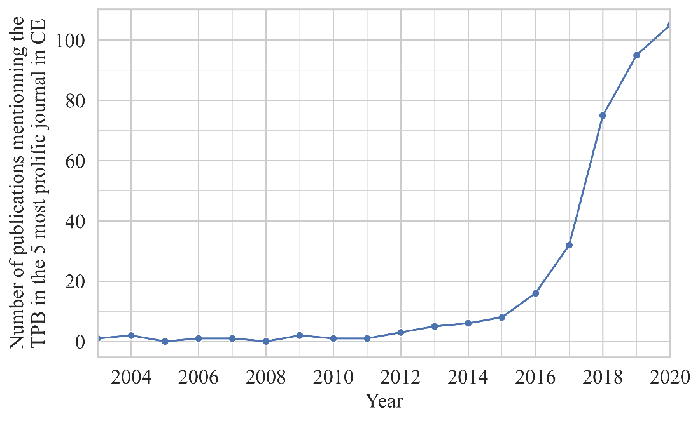
Background – Theory of Planned Behavior
How to define agents’ behavioral rules?
Advances in psychology can guide the design of the rules.
83+ theories of behavior change, related to each others.
The Theory of Planned Behavior (TPB) is one of the most popular:
Explain human behaviors based on 3 main factors: Attitude (𝐴), Subjective norms (𝑆𝑁), Perceived behavioral control (𝑃𝐵𝐶) (Ajzen, 1991).
Flexible: more latent variables can be added to the base framework.
Used in many contexts, including waste management (Geiger et al. 2019), to explain both organizations and households’ behaviors.
Increasingly used in industrial ecology and circular economy studies.
Network of behavior change theories (Gainforth et al. 2015)
(27 = Health Belief Model; 57 = Self Efficacy Theory; 63 = Social Cognitive Theory; 79 = Theory of Planned Behavior)
$$\begin{aligned}BI=w_{A}A+w_{SN}SN+w_{PBC}PBC\end{aligned}$$
Yearly number of publications mentioning the TPB in the five most prolific journals regarding CE
Notes:
Five most prolific journals regarding CE: Journal of Cleaner Production, Resource Conservation and Recycling, Sustainability, Waste Management, and Journal of Industrial Ecology

Slide 8
Examples

Slide 9
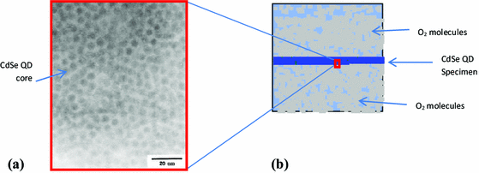
Examples – ABM are used in widely different fields
ABM has been used in multiple fields:
Ecology (Grimm et al., 2005), economics (Ponta et al., 2018), Fullstone et al., 2015), industrial ecology (Davis et al., 2009, Cucurachi et al., 2019).
Source: Agusdinata, D. B., et al. (2015). "Diffusion dynamics and concentration of toxic materials from quantum dots-based nanotechnologies: an agent-based modeling simulation framework." Journal of Nanoparticle Research 17(1): 26.
Notes:
Diffusion dynamics and concentration of toxic Cd2+ ions. Brownian motion dynamics are simulated + kinetics of reaction. Study the potential toxicity of nanomaterials released in the environment (water).

Slide 10

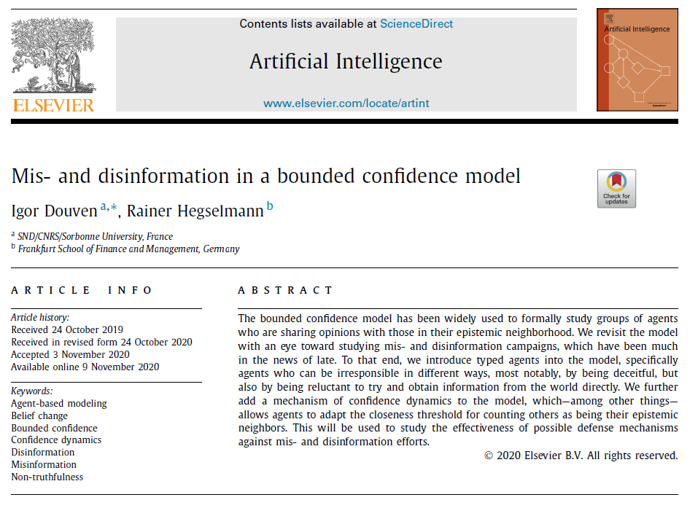
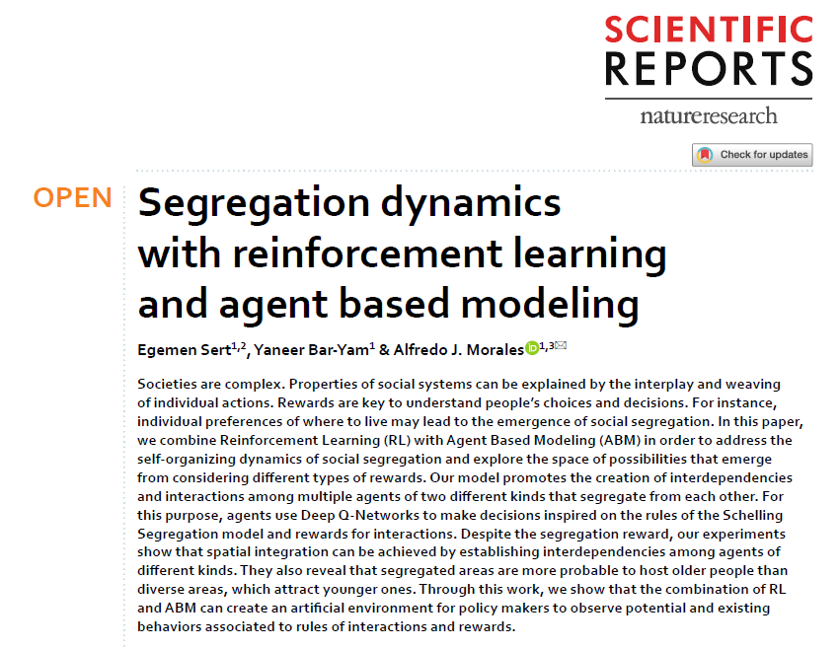
Examples – ABM are used in widely different fields
Other recent examples:
ABM of covid-19 spread in the Boston metropolitan area (Aleta et al., 2020).
ABM of the spread of mis and disinformation (Douven & Hegselmann, 2021).
An ABM revisiting Shchelling segregation model using reinforcement learning (Sert et al., 2020).

Slide 11
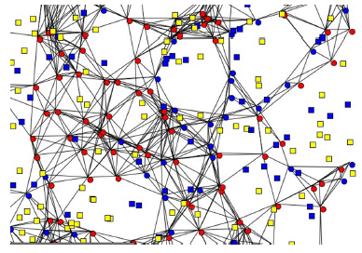
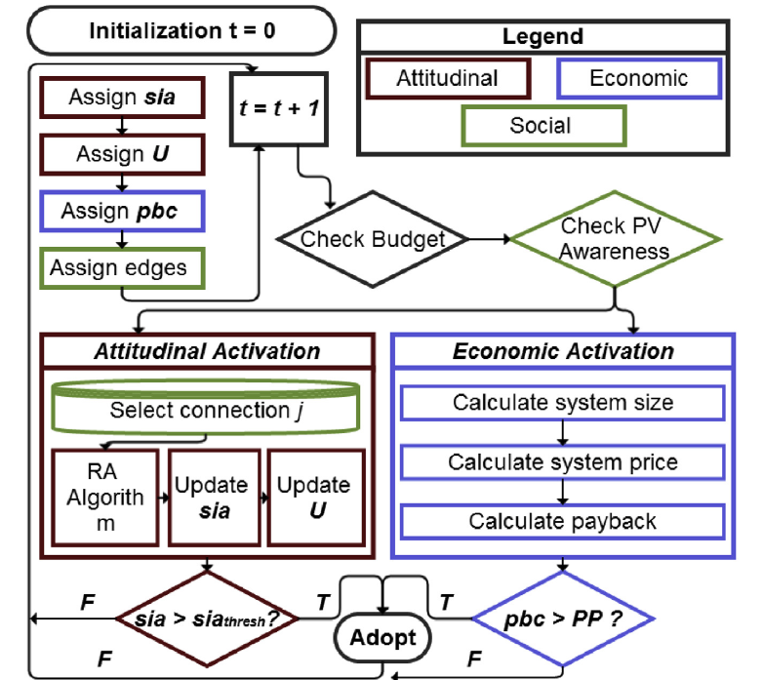
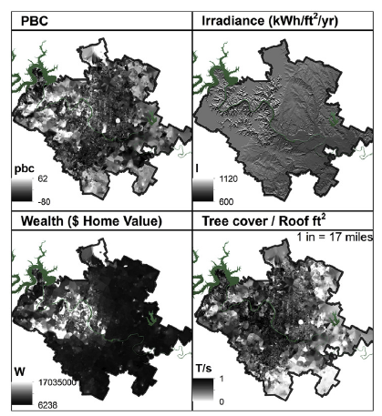
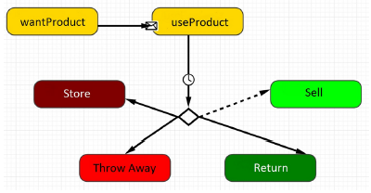
Examples – ABM are used in widely different fields
Rai & Robinson (2015), ABM of residential solar adoption
Mashhadi 2016-a, ABM of product take-back systems

Slide 12
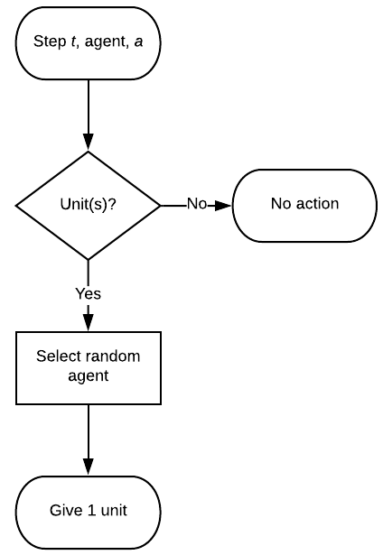
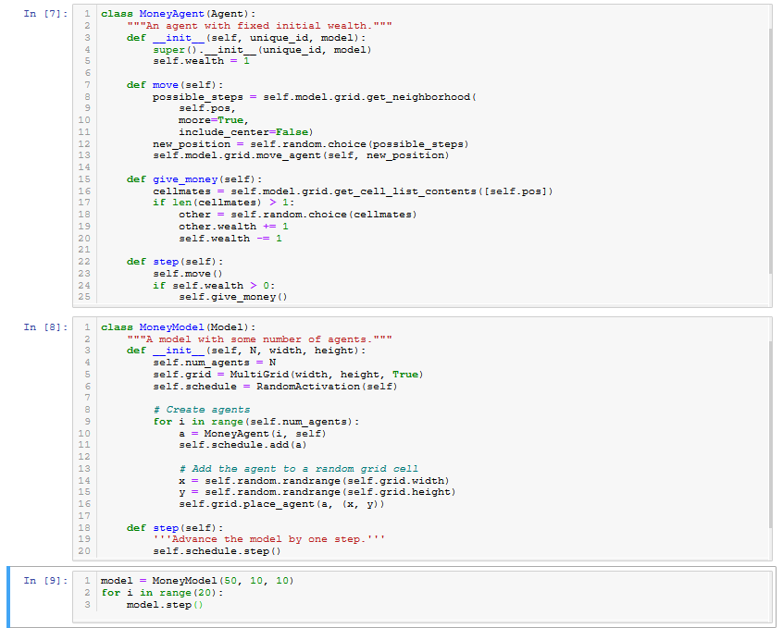
Examples – ABMs can be simple or sophisticated
We will study this model later on!
ABM can be highly sophisticated or fairly simple.
Rai & Robinson (2015), ABM of residential solar adoption → run on Texas Advanced
Computing Center’s supercomputer
MESA’s creators Boltzmann wealth model (MESA is a python library developed in 2015) → less than 50 lines of code
Notes:
A more sophisticated model is more robust to describe a specific situation → but difficult to generalize
A simpler model may not accurately describe some specific situations but may be more broadly applied → the Boltzmann wealth model could also be adapted and applied to study molecular speed in gas (hence the name of the model)

Slide 13
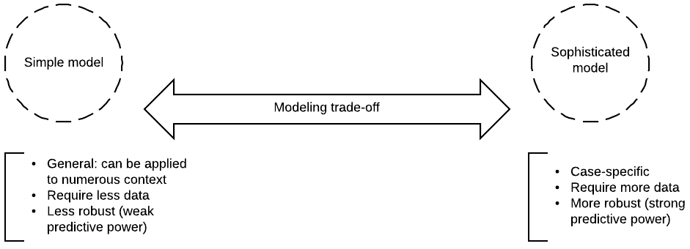
Examples – ABMs can be simple or sophisticated
…ABM may imply a trade-off between a simple more general model and a more sophisticated but case-specific model.
Modelers often start with a simple model that they extend into more sophisticated versions (Wilensky & Rand, 2015).

Slide 14
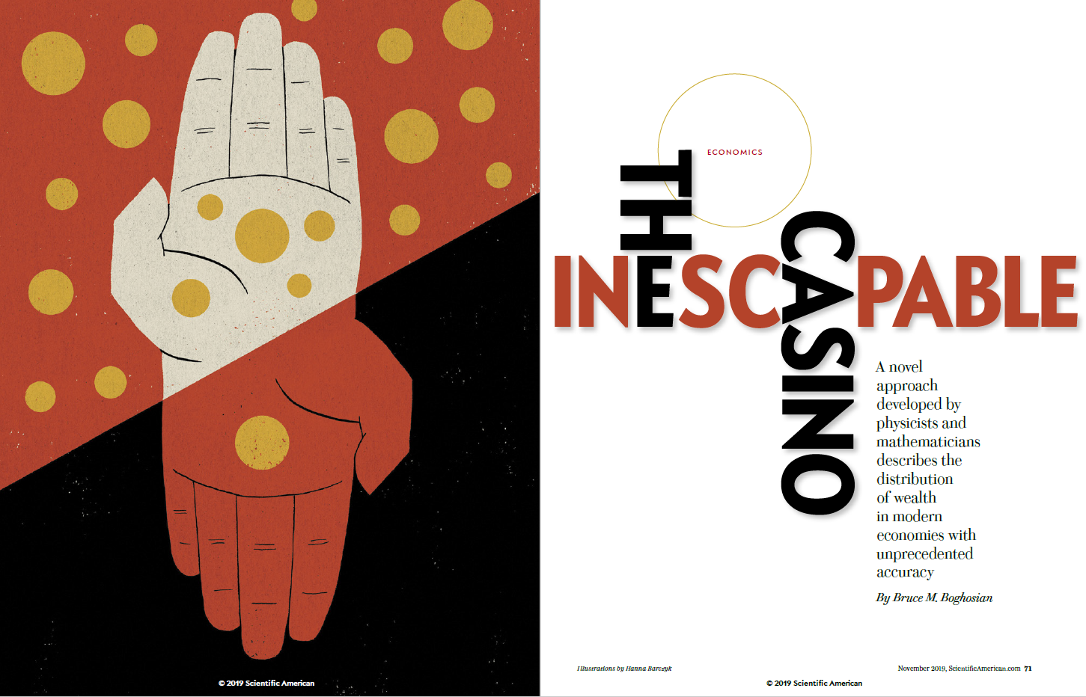
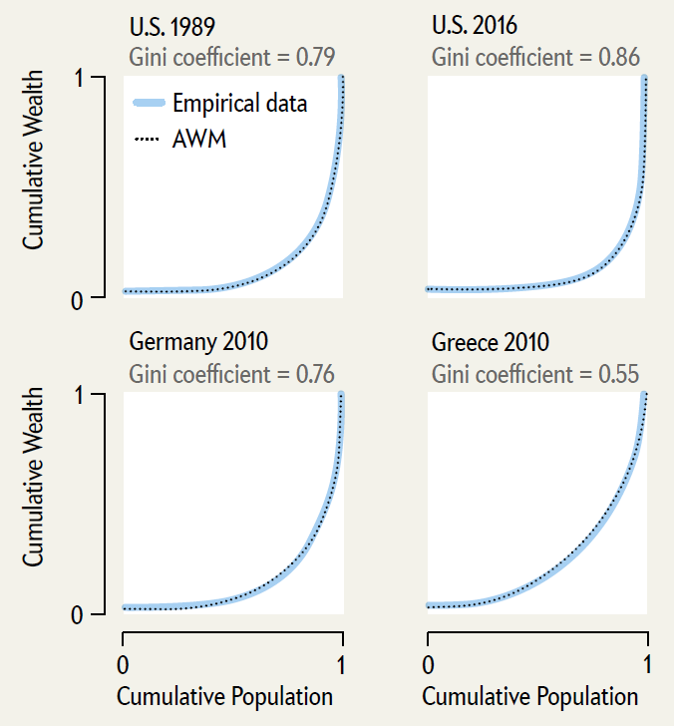
Examples – ABMs can be simple or sophisticated
Variants of the Boltzmann wealth ABM have been developed in the field of econophysics → the simple model has become more and more sophisticated as researcher iteratively improve it.
Boghosian, B. M. (2019). "The inescapable casino." Scientific American (November): pp. 70-77.
ABM which model wealth inequality across countries and time period with a surprising accuracy.
Novelty: agents may have a negative wealth (which more closely match real world as e.g., 10.5% of US population was in net debt in 2016).
Notes:
In physics, symmetry breaking is a phenomenon in which (infinitesimally) small fluctuations acting on a system crossing a critical point decide the system's fate, by determining which branch of a bifurcation is taken. To an outside observer unaware of the fluctuations (or "noise"), the choice will appear arbitrary. This process is called symmetry "breaking", because such transitions usually bring the system from a symmetric but disorderly state into one or more definite states. Symmetry breaking is thought to play a major role in pattern formation.

Slide 15
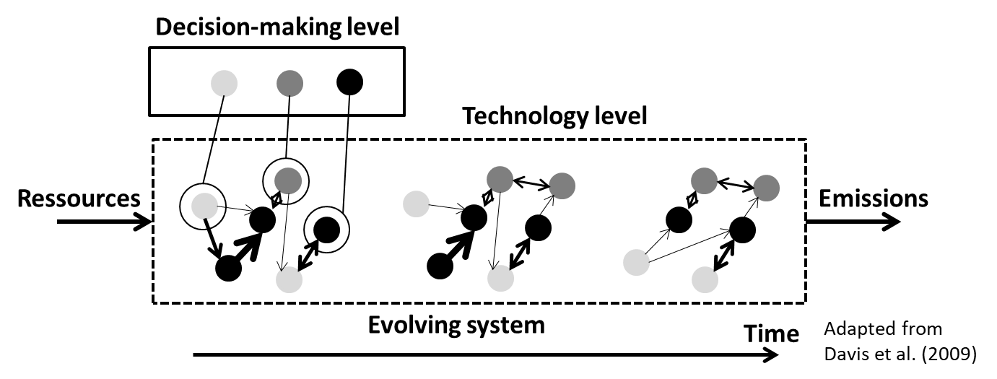
Examples – ABM and LCA
ABM has been used to model complex systems in LCA:
LCA and ABM can be combined unidirectionally or merged.
Examples include study of farmers’ adoption of biofuel crops, technological choice to produce electricity, LED adoption, green behavior adoption.
Notes:
References:
-Walzberg, J., et al. (2019). "Assessing behavioural change with agent-based life cycle assessment: Application to smart homes." Renewable and Sustainable Energy Reviews 111: 365-376.
-Micolier, A., et al. (2019). "To what extent can agent-based modelling enhance a life cycle assessment? Answers based on a literature review." Journal of Cleaner Production 239: 118123.

Slide 16
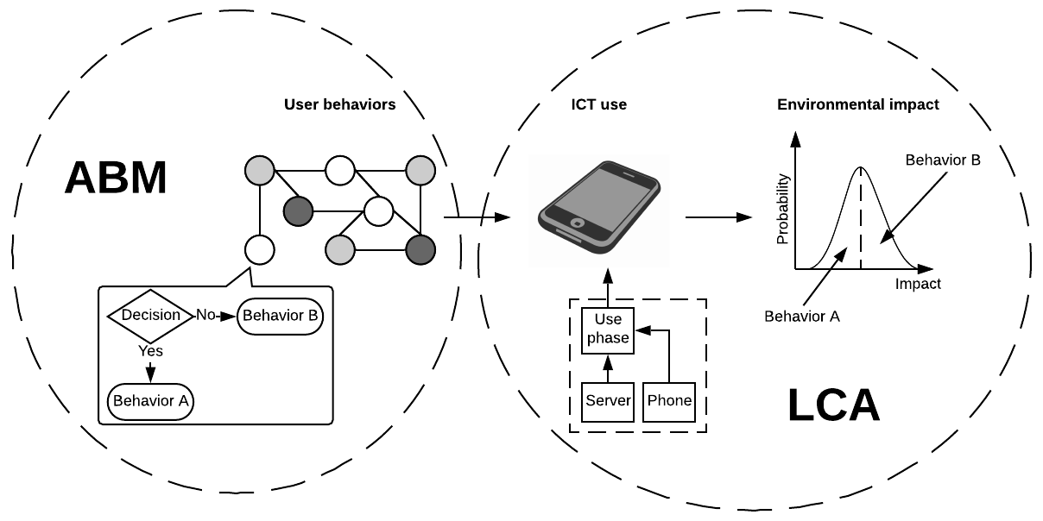
Examples – ABM and LCA
ABM of ICT use and behavioral change (Walzberg et al., 2019).

Slide 17
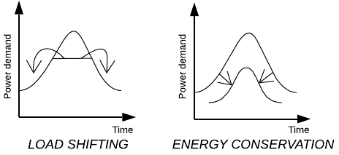
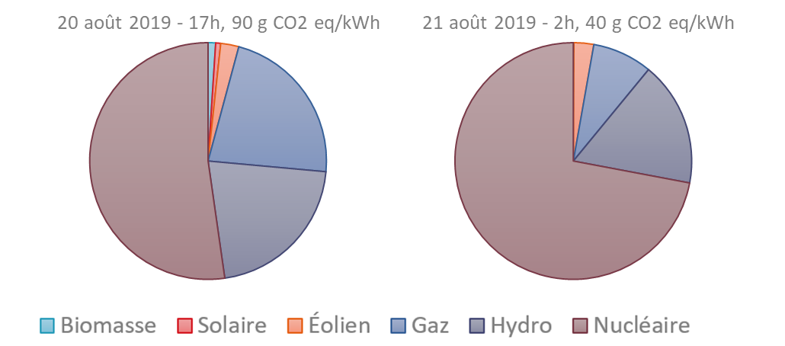
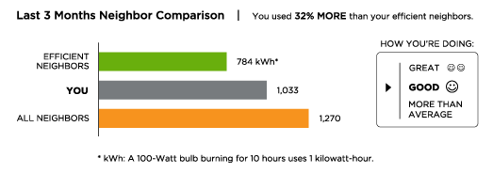
Examples – ABM and LCA
Use case = smart homes (in Toronto):
GOAL = reduce and/or shift in time electricity consumption.
MEANS = Comparative feedback (nudging), automation.
Sources: http://www.ieso.ca ; http://transcapitalist.com/transcapitalist/tag/opower
Notes:
Load shifting enables decreasing environmental impact without decreasing energy consumption (at same « comfort level »)

Slide 18
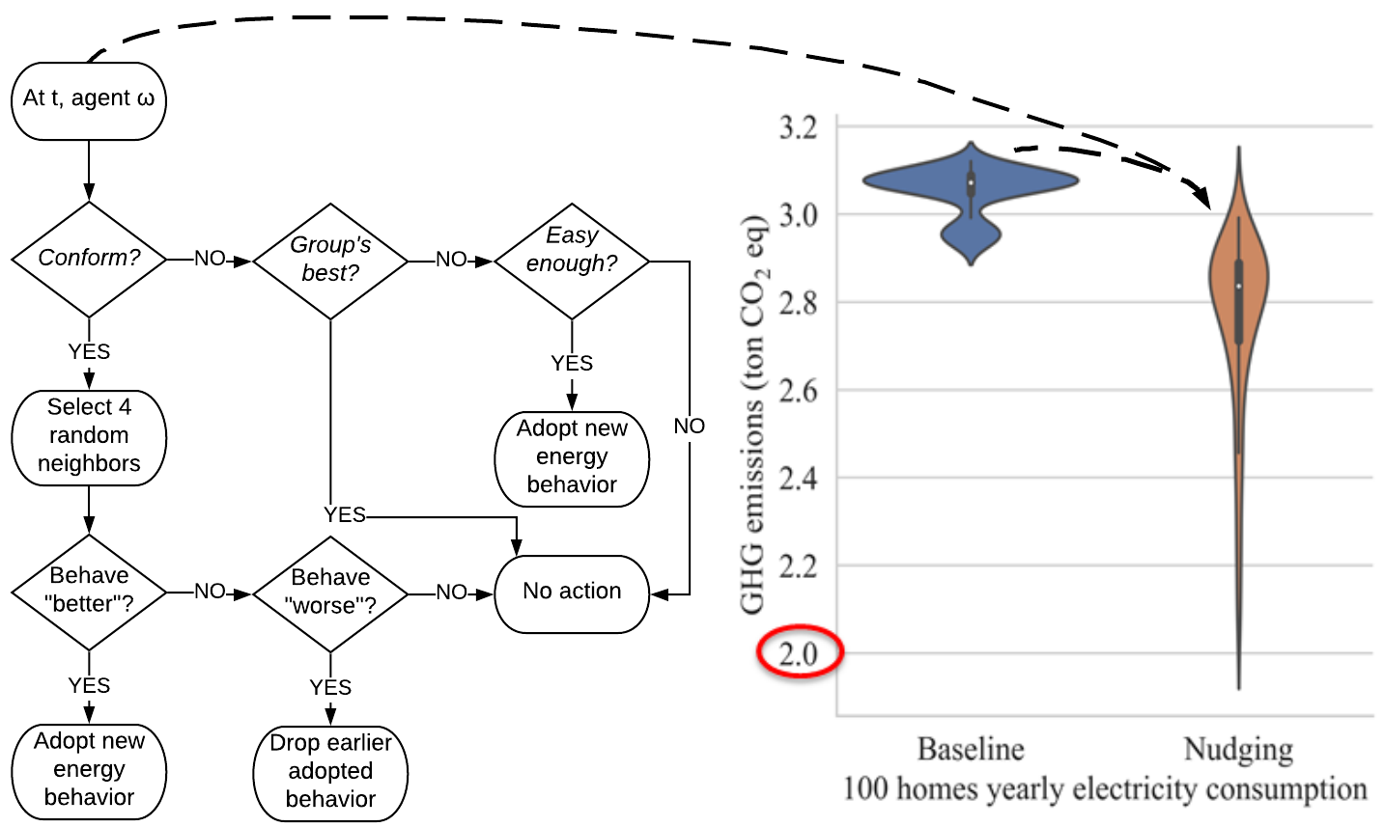
Examples – ABM and LCA
A more accurate modeling of the use phase with ABM enables studying the distribution of households' energy consumption environmental impacts and the effect of nudging on each individual consumption.
Agents’ decision rules follows social psychology model from Byrka et al. (2016).
Sources: Walzberg, J., et al. (2019). "Assessing behavioural change with agent-based life cycle assessment: Application to smart homes." Renewable and Sustainable Energy Reviews 111: 365-376.
Notes:
References:
-Byrka, K., et al. (2016). "Difficulty is critical: The importance of social factors in modeling diffusion of green products and practices." Renewable and Sustainable Energy Reviews 62: 723-735.
-Kaiser, F. G., et al. (2010). "Reviving Campbell’s Paradigm for Attitude Research." Personality and Social Psychology Review 14(4): 351-367.
-Walzberg, J., et al. (2019). "Assessing behavioural change with agent-based life cycle assessment: Application to smart homes." Renewable and Sustainable Energy Reviews 111: 365-376.

Slide 19
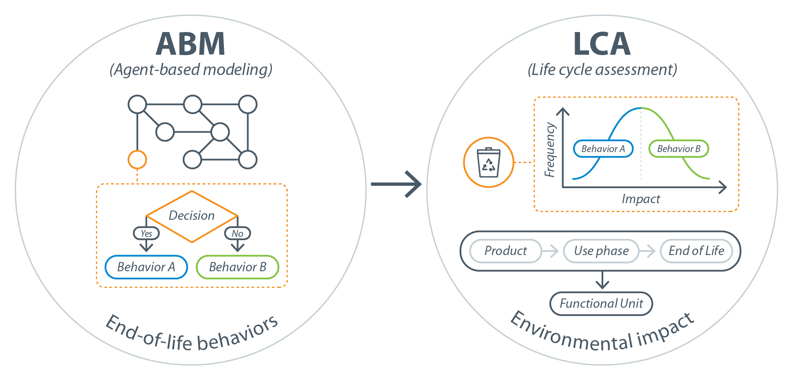
Examples – ABM and LCA
Example of the use of combined ABM and LCA in the context of the CE:
ABM represents the decisions of various CE actors (e.g., consumers, manufacturers, recyclers) and LCA evaluates the decisions’ environmental impacts.
For instance, a typical decisions for consumers would be, to recycle a product or dump it.
ABM provides better scenario modeling capacity that might lead to more realistic LCA results (Micolier et al., 2019).

Slide 20
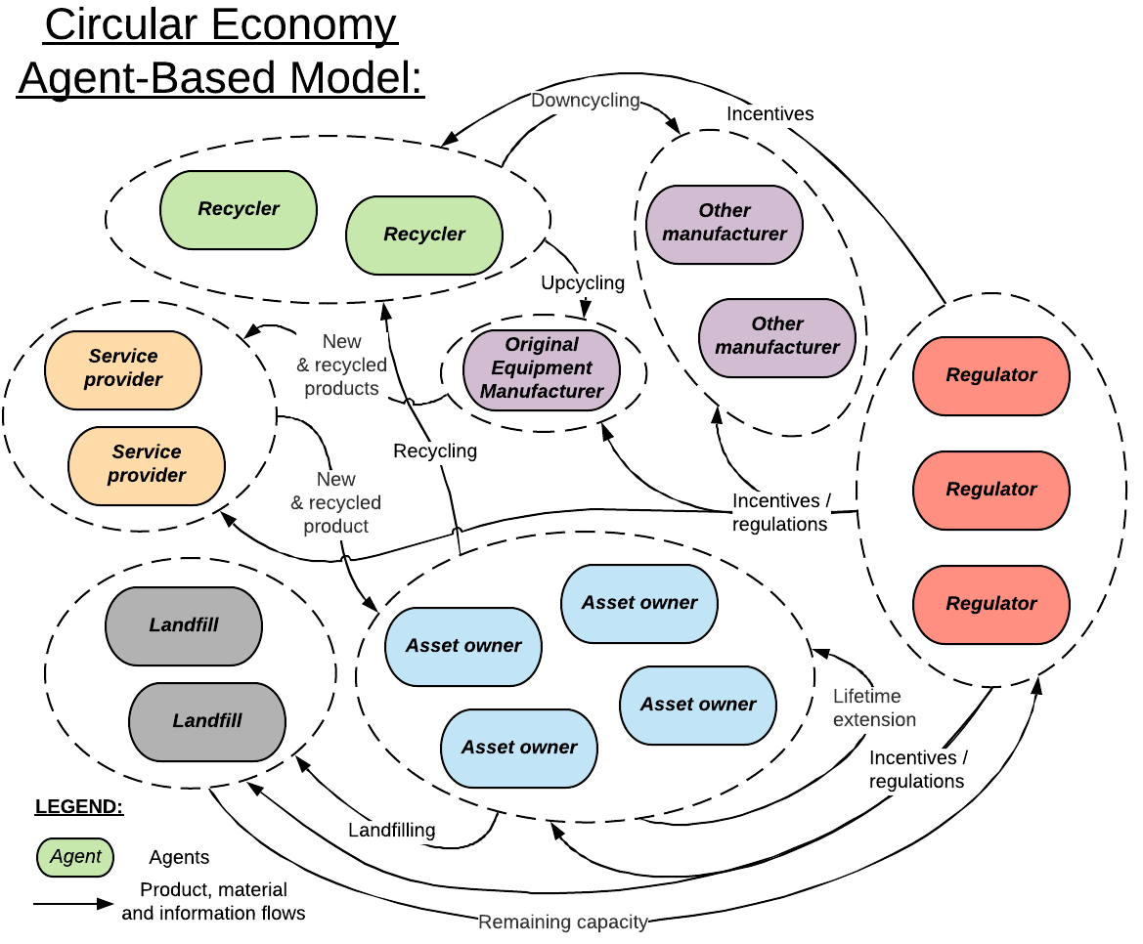
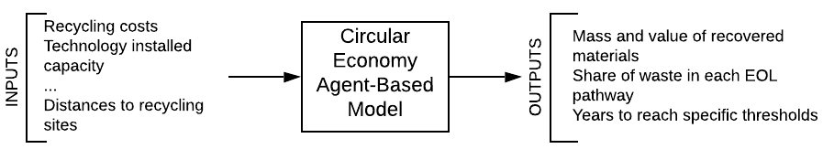
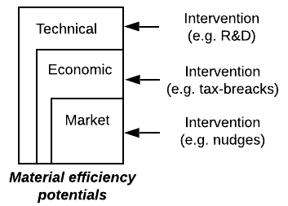
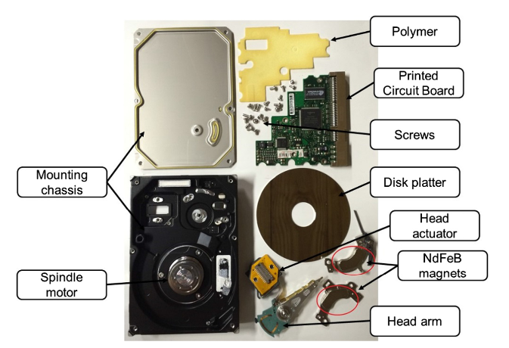
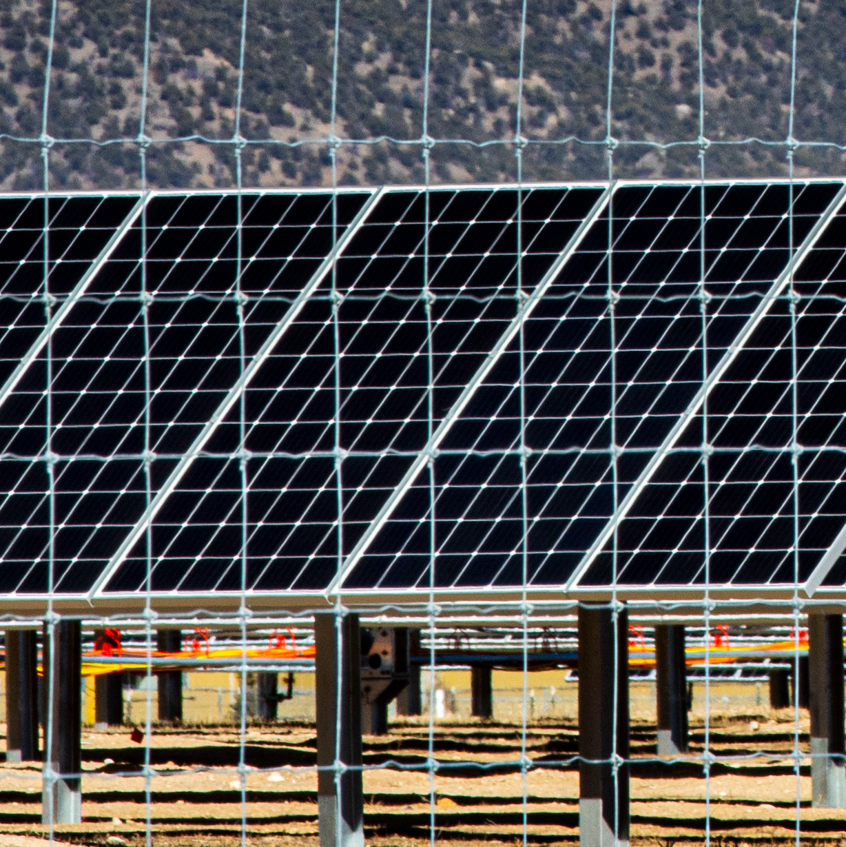

Examples – ABM and CE
PI: Alberta Carpenter, Garvin Heath, and Annika Eberle (alberta.carpenter@nrel.gov)
Core Team Members: Julien Walzberg, Robin Burton, and Aubryn Cooperman
Timeline: November 2019 to November 2021
Primary research question:
What are the technical, economic, and market conditions that maximize the value retention and minimize raw material inputs when applying CE strategies to energy-generating and energy-consuming technologies?
3 case studies:
+ PET bottles
PV
Hard-disk drives
Wind
Image sources: NREL Image Gallery, München and Veit (2017)

Slide 21
Examples – ABM and CE
Design concepts:
Model implementation:
Python with Mesa and NetworkX libraries (Git here)
Agent types are python classes (1 agent=1 class instance with instance methods (agents’ behavioral rules) and variables (agents’ characteristics))
The model python module activate agents and collect outputs
Modular design:
Mesa enables easily adding new agent types to the model as new python modules
Networkx facilitate the construction of networks to define agents’ relationships and include geographical elements
Simulations:
Time step = 1 year
Studied period = 2020-2050
Scope: the United States

Slide 22
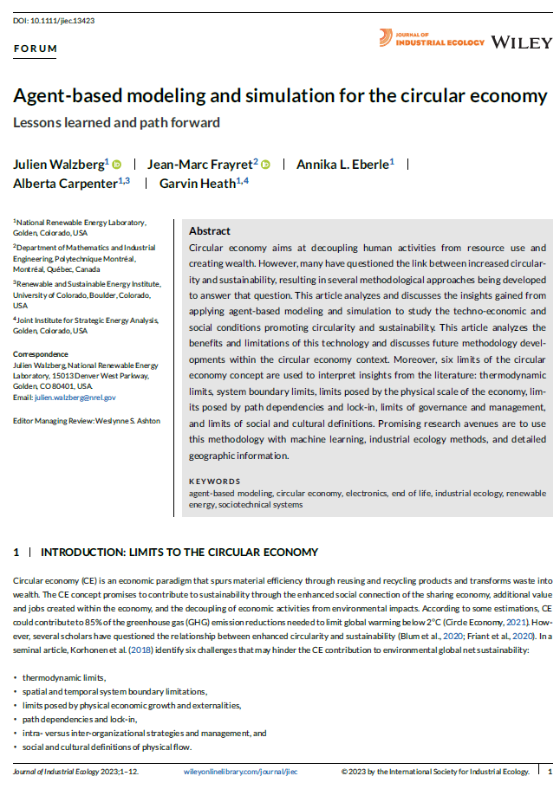
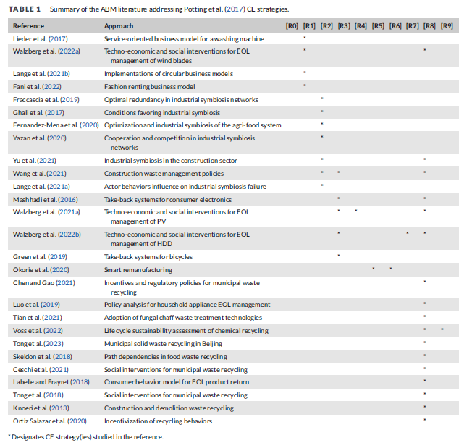
Examples – ABM and CE
Many ABM have been developed to study circularity:
Walzberg, J., Frayret, J.-M., Eberle, A. L., Carpenter, A., & Heath, G. (2023). Agent-based modeling and simulation for the circular economy: Lessons learned and path forward. Journal of Industrial Ecology, n/a(n/a). doi:https://doi.org/10.1111/jiec.13423

Slide 23
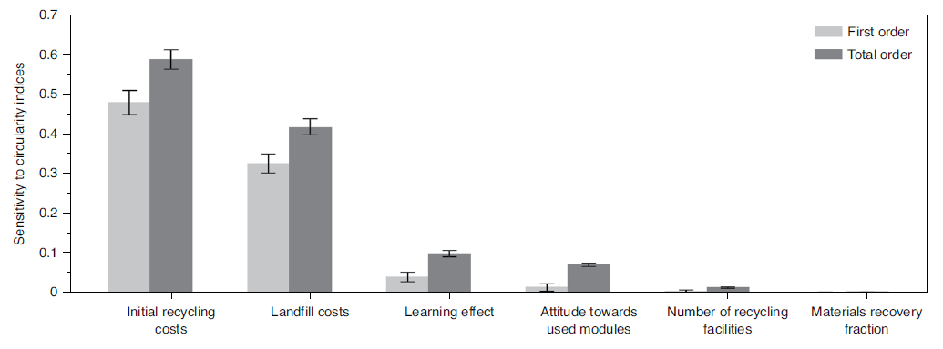
Examples – ABM and machine learning
Combining ML and ABM is a recent trend that has several advantages (Rand, 2019), either to:
Explore ABM’s parameter space (Vadhati et al. 2019).
Design ABM’s behavioral rules (Zhang et al. 2016).
Machine learning (ML) algorithm can help explore an ABM in depth faster:
The training dataset is generated with the ABM (e.g., using Sobol sequences to cover as much of the parameter space as possible with the minimum number of samples).
The ML algorithm can generate results for parameter combinations not initially run with the ABM.
With the help of a machine learning metamodel, a Sobol sensitivity analysis is conducted for the PV case study: 2810 parameter combinations (Sobol sequences) were used to train a neural network. The Neural network is then used to generate 70000 samples, enabling a robust Sobol sensitivity analysis.
Walzberg, J., Carpenter, A., & Heath, G. A. (2021). Role of the social factors in success of solar photovoltaic reuse and recycle programmes. Nature Energy. doi:10.1038/s41560-021-00888-5

Slide 24
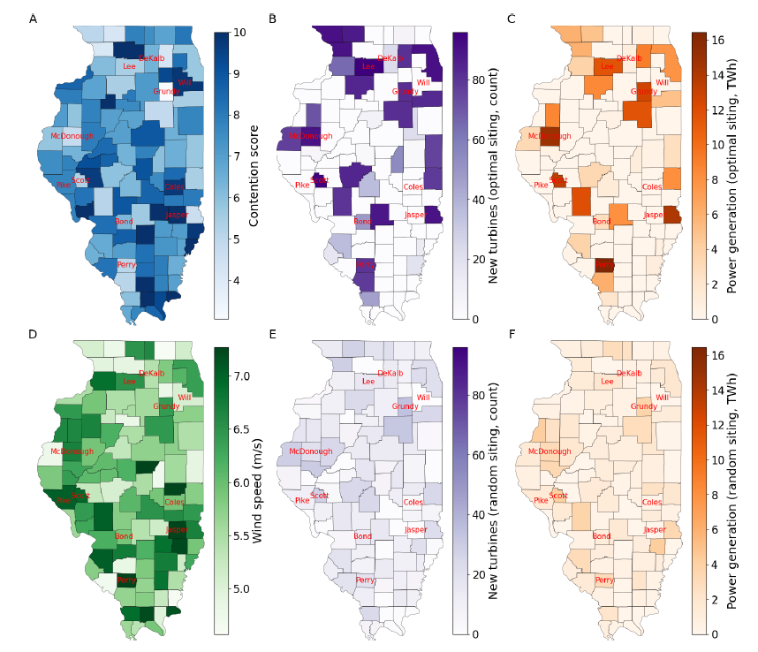
Examples – ABM and machine learning
Wind acceptance model: uses an ABM framework and a reinforcement learning (RL) algorithm to minimize potential delays due to contention while maximizing power generation:
Agents are used to model wind plant projects heterogeneity (e.g., regarding their number of turbines and installed capacity) and siting decisions (including their consequences in term of delays or successful siting).
RL (the Q-learning algorithm in our case) provides a means to optimize those decisions. The Q-learning algorithm is applied in a top-down way (i.e., one Q-table rather than agents having individual Q-tables).
Agents make optimal decisions through reinforcement learning. Contention risks (A), wind resources (D) and siting according to the trained (B,C) and nontrained (E,F) RL model measured by the number of turbines and power generation across Illinois. Agents trained with the RL algorithm learned to avoid siting locations where contention risks are high and to seek siting locations with high wind speed.
Walzberg, J., & Eberle, A. (2023). Modeling Systems&rsquo; Disruption and Social Acceptance&mdash;A Proof-of-Concept Leveraging Reinforcement Learning. Sustainability, 15(13), 10231. Retrieved from https://www.mdpi.com/2071-1050/15/13/10231

Slide 25
ABM of household recycling behaviors

Slide 26
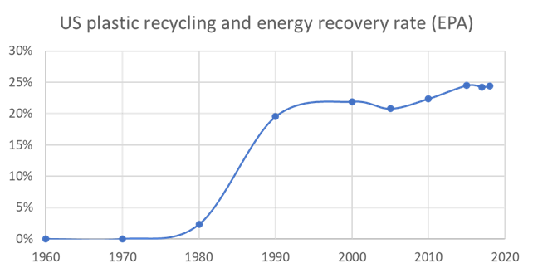
Problem Statement
The US recycling rate has plateaued in the past few years; if anything, it is decreasing slightly.
In 2018 about 32% of the 292 million tons of MSW was sent to recycling and composting programs.
The US MSW recycling rate lags behind other developed countries (e.g., Switzerland = 51%, UK = 43%).
Contamination issues hinder recycling.
Recycling behaviors are highly contextual making “one-size-fits-all” solutions sub-optimal.

Slide 27

Overarching framework summary
End-of-life pathways are compared with the Plastic Parallel Pathways Platform (4P)
Framework currently focuses on PET bottles but could be applied to any material
Collection is modeled with Agent-Based modeling (ABM)
Different recycling technologies are modeled

Slide 28
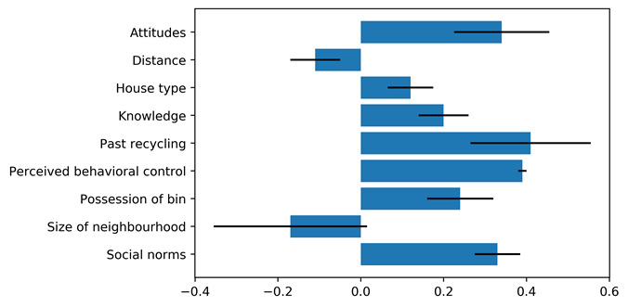
Agent-based modeling – Background
Many factors may affect people’s recycling behaviors (Raghu & Rodrigues, 2020):
Psychological factors.
Situational factors.
Community factors.
Demographic factors.
Geiger et al. quantitative meta-analysis of factors affecting recycling behaviors:
Analyzed 91 empirical studies.
Psychological and situational factors can be targeted to up recycling:
Reducing traveled distance (e.g., by developing curbside recycling programs).
Providing information feedback (e.g., via inspection and cart tagging in Olympia, WA).
Effect sizes of some of the psychological and situational factors affecting recycling identified in Geiger et al., 2019 meta-analysis – error bars = 95% confidence interval

Slide 29
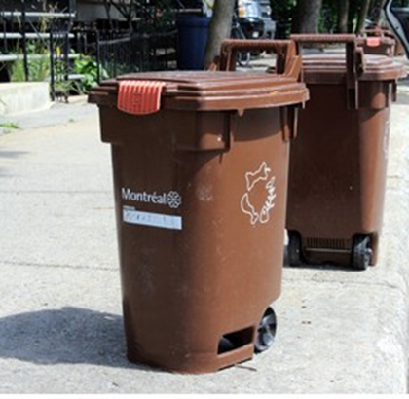
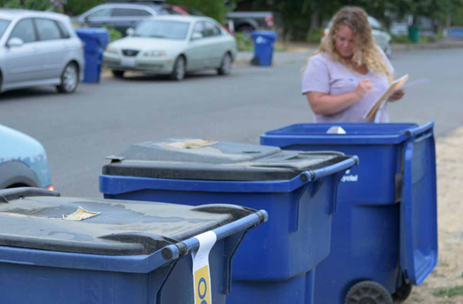
Agent-based modeling – Background
Examples of behavioral interventions:
Information feedback (via inspection and cart tagging) in Olympia, WA
Source: https://resource-recycling.com
Composting bins in Montréal, Canada
Source: https://www.shutterstock.com

Slide 30
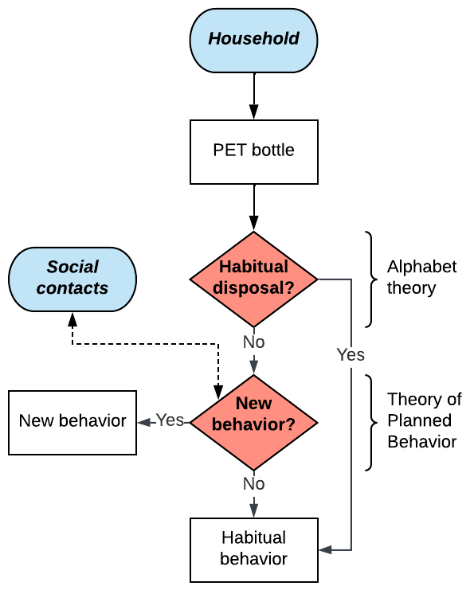
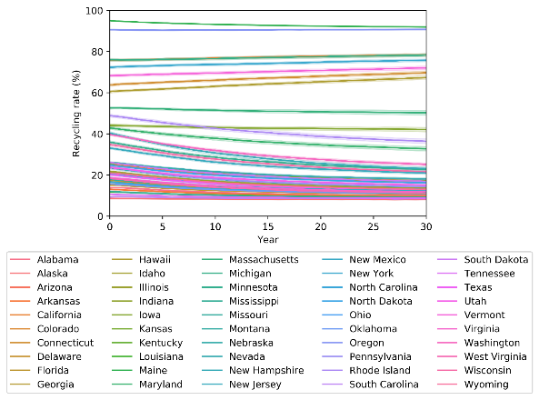
Agent behavioral rules
ABM’s objective: model household recycling behaviors under different intervention scenarios.
Three behavior adoption dynamics are modeled: trash, recycling, and “wishcycling”.
Agents (households) behavioral rules:
The habitual nature of the disposal behavior (i.e., trash versus wishcycling/recycling) is captured.
If the agent “ponder” his disposal behavior (i.e., not habitual), variables from Geiger et al. are used to define the probability that a given behavior is adopted.
Probabilities are used to represent agents’ bounded rationality and factors not considered in the ABM (e.g., attitude-behavior gap).

Slide 31
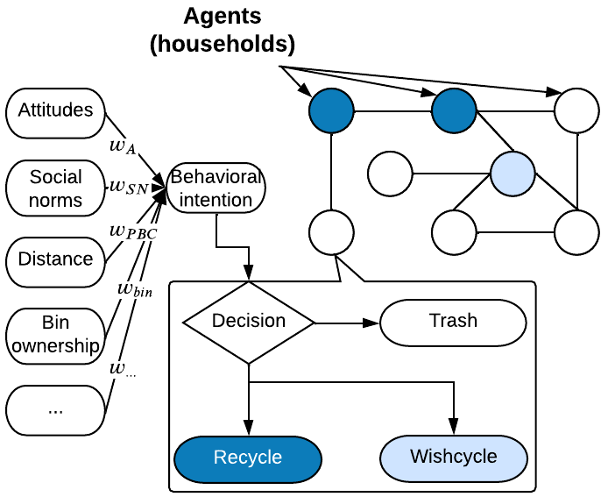
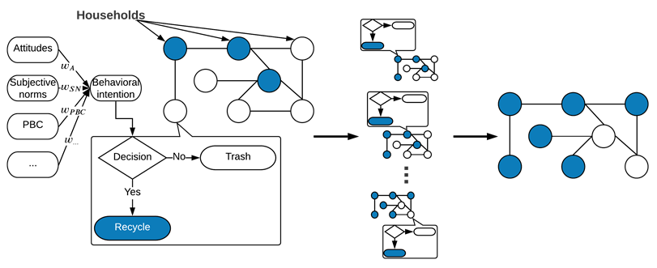
Agent behavioral rules

Slide 32
Baseline and intervention scenarios
*All interventions are applied over a 10-year period
Scenario* | Affected behavior | Access (e.g., curbside vs drop-off) | Knowledge (education level) | Attitude | Bin ownership | Perceived behavioral control (incentives)
Baseline | – | Depends on state (The Recycling Partnership (TRP)) | Depends on state (Census Bureau) | 84% positive (Carton Council of North America) | 72% own a bin (Cone Communications Recycling in the home Survey) | Depends on state (50 states of recycling report)
Scenario 1: Equitable Access | Recycling (+), wishcycling (+) Break habits | 100% easy access | – | – | – | –
Scenario 2: Education | Recycling (+) Break habits | – | 100% knowledgeable | 100% positive | – | –
Scenario 3: Cart Tagging | Wishcycling (-) Break habits | – | – | – | 0% use recycling bin inappropriately | –
Scenario 4: Deposit Return System (DRS) | Recycling (+), wishcycling (-) Break habits | 100% easy access | – | 100% positive | 0% use recycling bin inappropriately | 100% financial incentives
Notes:
According to the recycling partnership (2021), funding could come from state-level Extended Producer Responsibility (EPR) programs – e.g., in Oregon, the Senate Bill 582 truth-in-labeling dispositions will push producer responsibility organizations to increase households’ recycling knowledge by avoiding misleading and confusing claims regarding the recyclability of products

Slide 33
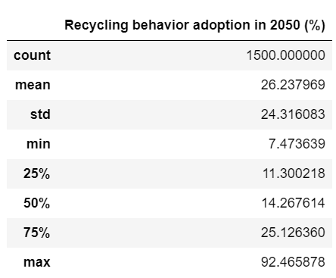
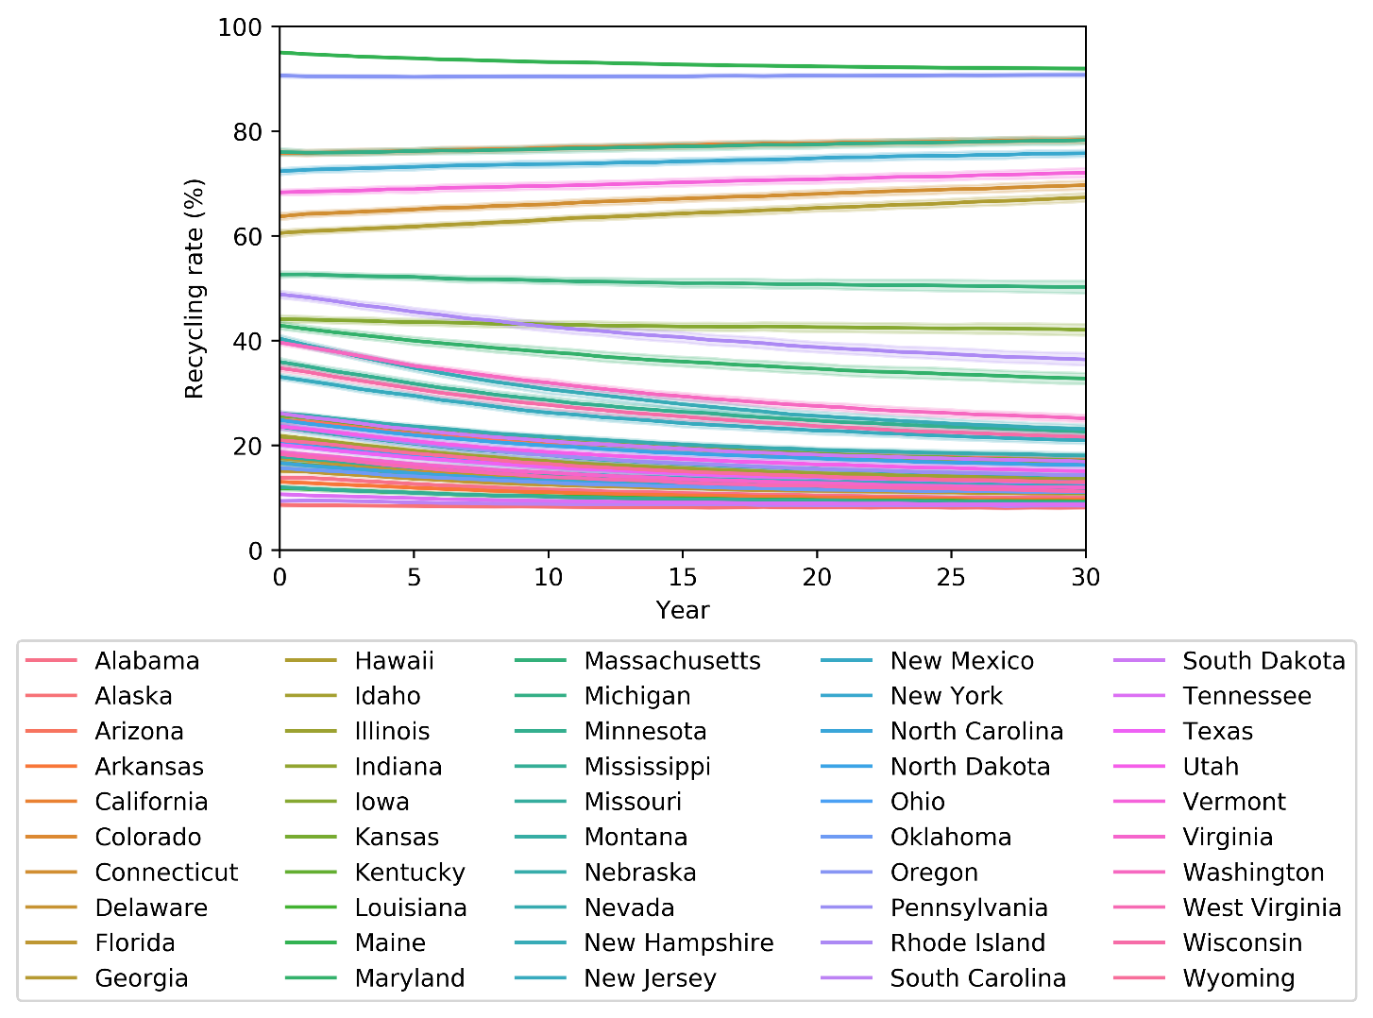
Baseline results

Slide 34
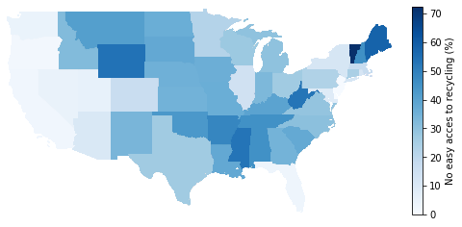
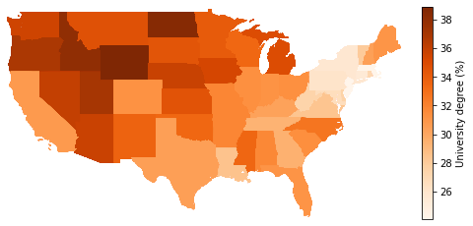
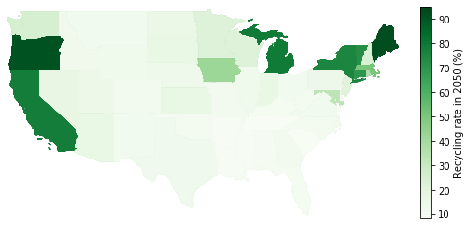
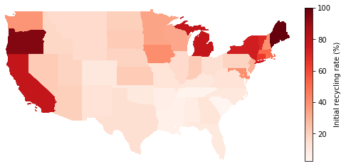




Baseline results
$←$ Input data
ABM results $→$
Baseline results:
The model is calibrated under the assumption that without any interventions, collection rates remain constant
Past recycling habits and the presence of a bottle bill are mainly responsible for maintaining the status quo
The decision model variables are assumed to remain constant

Slide 35




Intervention scenario results
Intervention scenario effects:
Equitable access increases the collection rate by 14 points
Education increases the collection rate by 20 points
Cart tagging decreases the contamination rate by a third
DRS increases the collection rate by 41 points

Slide 36



Intervention scenario results
Interventions targeting different agents’ characteristics have diverging effects regionally – increased education affects southern states the most (B) while Equitable access mostly affects the West, Midwest and South (A)
Red circles: the interventions are most effective in regions with low access to curbside recycling or low knowledge of recycling
Yellow circles: in regions with already high collection rates, interventions have low effects
Grey circles: in some cases where access or knowledge is already high, interventions may still prove effective as they may break “bad” wishcycling and trash habits
A: Equitable access scenario
B: Education scenario

Slide 37


Avoided impacts from higher PET waste collection
Assumptions:
Equitable access scenario
Close-loop recycling → all collected PET bottle waste converted into oligomers via glycolysis and used to make new PET bottles
Electricity mix decarbonizes according to projections from the Regional Energy Deployment System (ReEDS) model
Contributions from Florida and Texas dominate the results:
Top two PET bottle waste generators
Equitable access intervention is effective in those states increasing the collection rate by $\sim$18%
In California and New-York the equitable access scenario only raises collection rates by $\sim$5% but they are also top PET waste generators → 3rd and 4th contributors of avoided GHG emissions
Increased access to recycling programs avoids virgin plastic manufacturing and GHG emissions but as electricity decarbonizes, benefits lower

Slide 38
Avoided impacts from higher PET waste collection
According to the recycling partnership:
Better access to recycling programs would cost about $8.5 per household per year
Education and outreach would cost about $10 per household per year
Which intervention should we prioritize? It depends on:
The goal of the intervention: i) avoid plastic waste in the environment (i.e., increasing collection), ii) increasing resilience (i.e., avoid virgin manufacturing), iii) mitigating climate change (i.e., avoid GHG emissions)
The state:
What is the initial collection rate
What is the local electricity mix (and how it will evolve)
How populated is the state and how much PET bottle waste is generated
State | Equitable access (per million $ invested) | Education (per million $ invested)
Alabama | Waste collection: +0.11% Virgin plastic: -1300 Mt GHG emissions: -100 Mt CO₂ eq | Waste collection: +0.14% Virgin plastic: -1600 Mt GHG emissions: -85 Mt CO₂ eq
California | Waste collection: +0.02% Virgin plastic: -2200 Mt GHG emissions: -37 Mt CO₂ eq | Waste collection: +0.02% Virgin plastic: -1700 Mt GHG emissions: -31 Mt CO₂ eq
Nevada | Waste collection: +0.32% Virgin plastic: -2400 Mt GHG emissions: -99 Mt CO₂ eq | Waste collection: +0.27% Virgin plastic: -1800 Mt GHG emissions: -82 Mt CO₂ eq
Vermont | Waste collection: +0.57% Virgin plastic: -970 Mt GHG emissions: -54 Mt CO₂ eq | Waste collection: +1% Virgin plastic: -1600 Mt GHG emissions: -45 Mt CO₂ eq

Slide 39

Conclusions
Recycling behaviors are highly contextual making “one-size-fits-all” solutions sub-optimal
ABM is calibrated using Census Bureau and other data to fit reported PTE bottle state-specific recycling rates
Results show that known interventions affect populations differently depending on their characteristics
Limitations:
Data had different geographical resolutions, some defined at the block group level, others at the state level, and some at the national scale
Focusing on disposal behavior may miss how series of behaviors form intricate patterns: decisions and actions throughout the day may affect disposal behaviors
Possible next steps:
Apply the model to a case study with a finer resolution (e.g., a single state at the county or census track level)
Apply the model to other containers and packaging materials
Walzberg, J., Sethuraman, S., Ghosh, T., Uekert, T., & Carpenter, A. (2023). Think before you throw! An analysis of behavioral interventions targeting PET bottle recycling in the United States. Energy Research & Social Science, 100, 103116. doi:https://doi.org/10.1016/j.erss.2023.103116

Slide 40
Practical example using Python
Thank you, any questions?
https://github.com/jwalzberg/ACLCA_Workshop_AB-LCA/

